Slide 1
PROGRAMMING FOR DATA ANALYSIS (CT127-3-2-PFDA)
Name: Shivam Ranabhat
Student ID: NPI000047
Assignment Topic: Hourly Weather Data Analysis
Present to: Mr. Sandeep Adhikari

Slide 2
INTRODUCTION
Use different data analyzing and manipulation techniques
Explore the given weather data
Extract the information
Data set which contains two origins
John Kennedy International Airport (JKF)
LaGuardia Airport (LGA) of the United States
Consists of 15 columns and 17, 412 rows
Column names: Origin, year, month, day, hour, temp, dewp, humid, wind_dir, wind_speed, wind_gust, precip, pressure, visib, time_hour

Slide 3
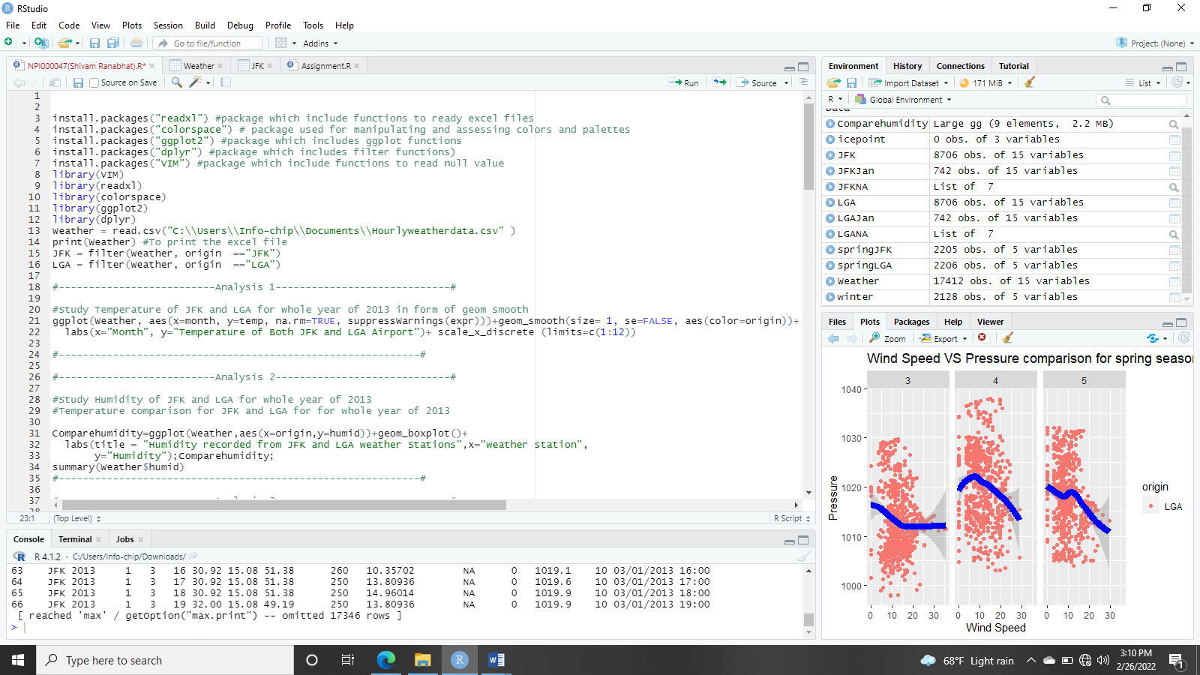
Data import and pre-processing
Install Packages
Load Packages
Read Csv File
Pre-processing
Origin filtering

Slide 4
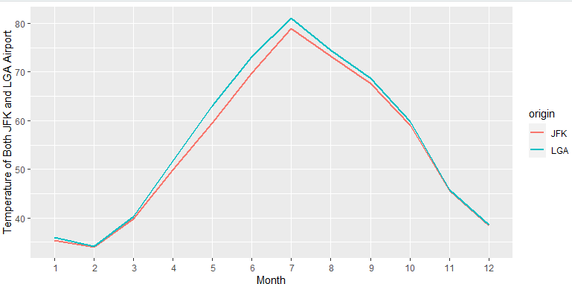
Analysis
Analysis 1: Comparing overall temperature of JKF and LGA
LGA has maximum temperature
Same minimum temperature (July)
Minimum temperature in February
Increasing from February and to July
Slowly decreasing from July to
December

Slide 5
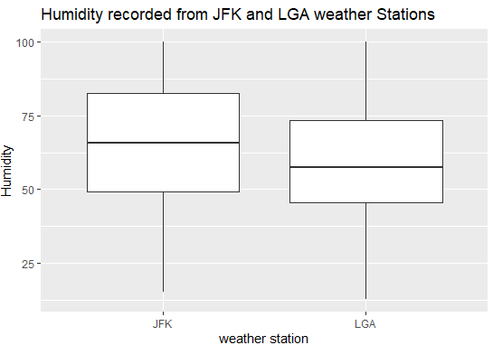
Analysis
Analysis 2: Comparing humidity of overall year of JKF and LGA
Maximum humidity is the same throughout the
year 2013
Humidity is minimum in LGA than JFK
median of humidity is higher in JFK than LGA
Greater value of 1st and 3rd quartile for
humidity in JFK LGA

Slide 6
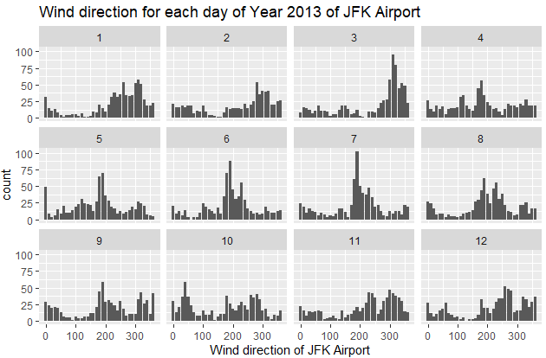
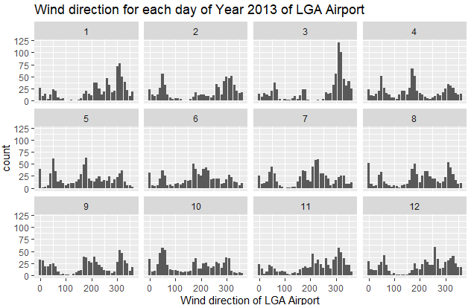
Analysis
Analysis 3: Comparing wind direction of overall year of JKF and LGA
Same maximum and minimum value for wind direction in both airports
March, June, and July the wind direction is found to be higher

Slide 7
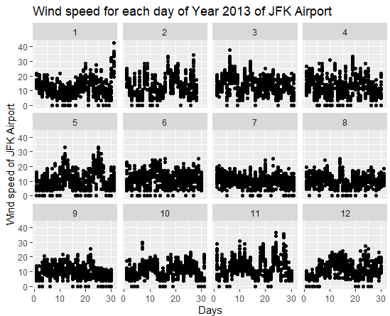
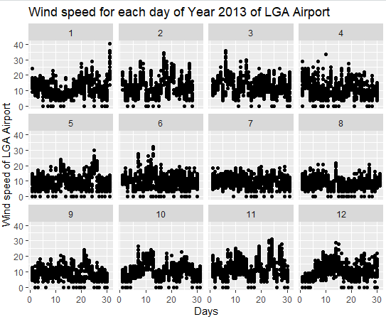
Analysis
Analysis 4: Comparing wind speed of overall year of JKF and LGA
Maximum wind speed in January of both airports
But maximum in JFK than LGA airport which is found to be 42.579 mph
Minimum value is the same for both JFK and LGA which is 0 mph

Slide 8
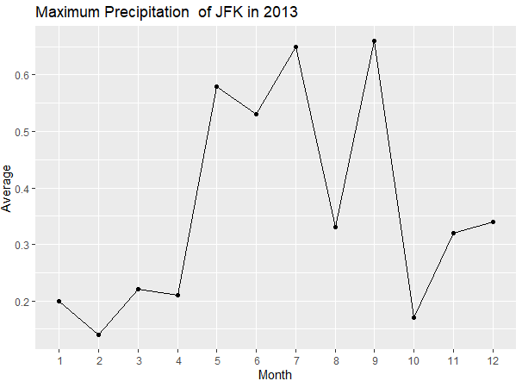
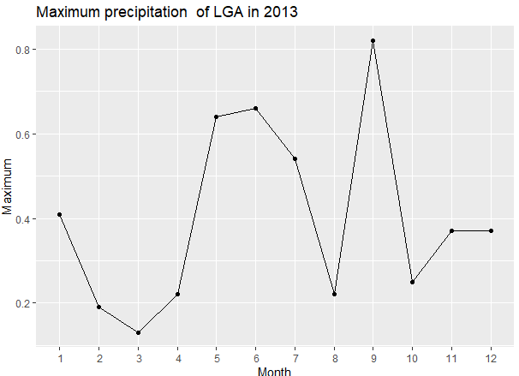
Analysis
Analysis 5: Comparing maximum precipitation of overall year of JKF and LGA
Maximum precipitation is found in LGA airport (July and September)
LGA had maximum precipitation(0.82 inches) in September
JFK has maximum precipitation is found to be 0.66 inches
Same minimum precipitation value in both

Slide 9
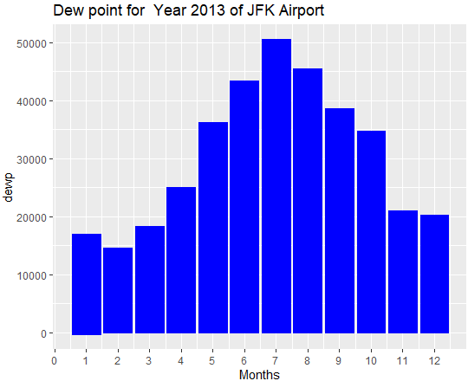
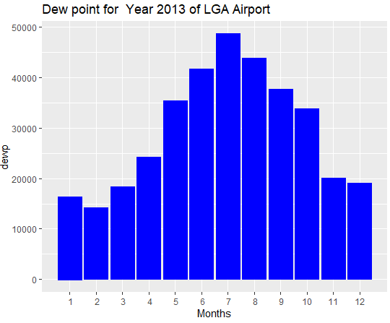
analysis
Analysis 6: Comparing dew point of overall year of JKF and LGA
JFK has maximum value of dew point in July (78.78 degree Fahrenheit)
LGA has maximum value of dew point in July (73.94 degrees Fahrenheit)
LGA has minimum value of dew point in February than JFK (-7.06 degrees Fahrenheit)

Slide 10
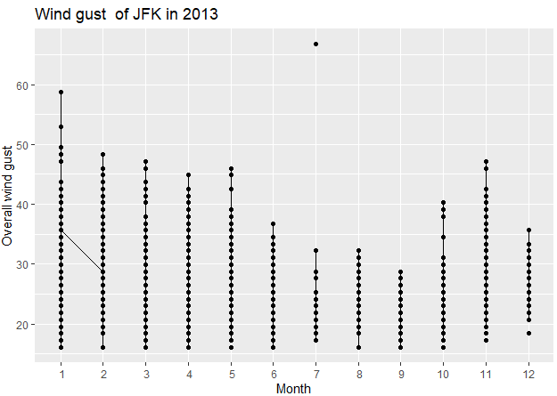
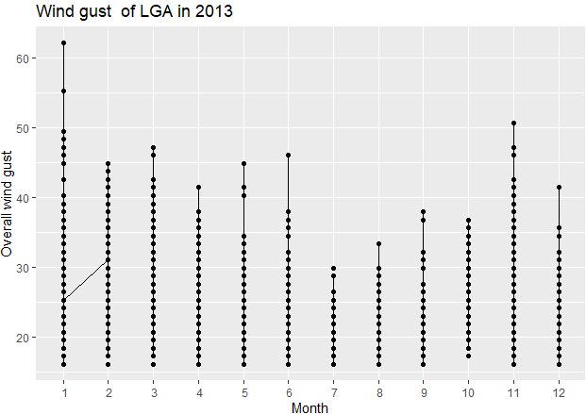
analysis
Analysis 7: Comparing wind gust of overall year of JKF and LGA
Wind gust is higher in JFK in July which is 66.75 mph
In LGA maximum wind gust is found in the month of is 62. 14 mph
Same minimum value (16.11 mph) for wind gust in both JFK and LGA

Slide 11
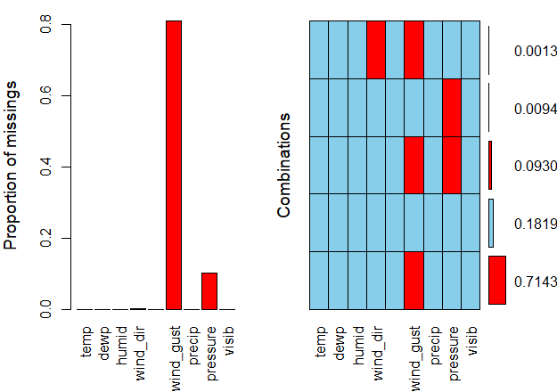
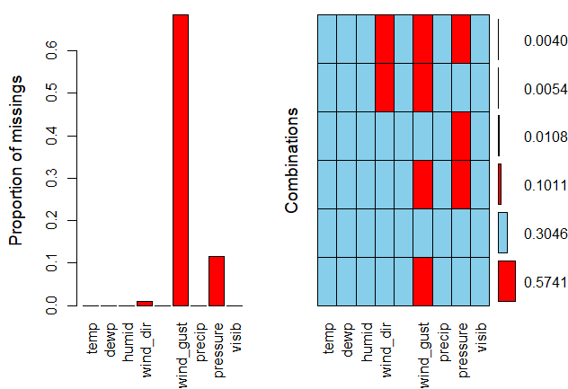
analysis
Analysis 8: Finding null value of January 2013 of JKF and LGA
Most NA values are found in JFK airport
Mostly missing in wind_gust and then pressure and wind_dir in both airports
Missing value of wind_dir is found more in LGA than in JFK airport

Slide 12
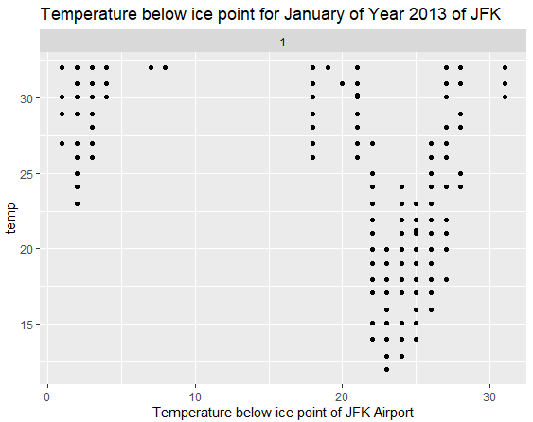
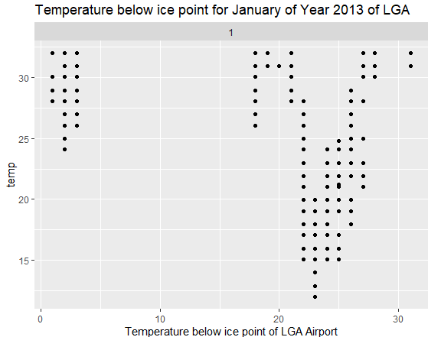
analysis
Analysis 9: Comparing January temperature below ice point of JKF and LGA
Temperature ice point of both airports is found almost similar.
Minimum value of temperature below ice point is also the same for both airports
Temperature below the ice point not found(10 to day 15 in JFK and day 5 to day 15 in LGA)
Mostly found on day 25 to day 27

Slide 13
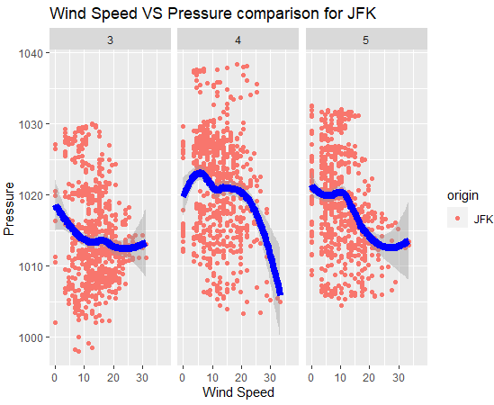
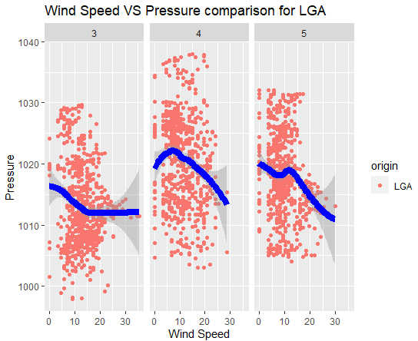
Analysis
Analysis 10:Comparing wind speed and pressure of spring season
When there minimum wind speed there is maximum pressure
In JFK the wind speed and pressure are found maximum than LGA
In April of JFK, the lowest pressure is found and in May of LGA, the pressure is minimum
Inversely proportional relationship between the wind speed increases pressure.

Slide 14
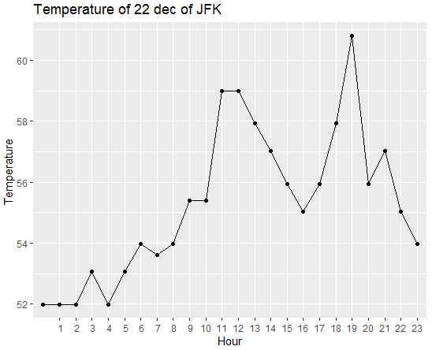
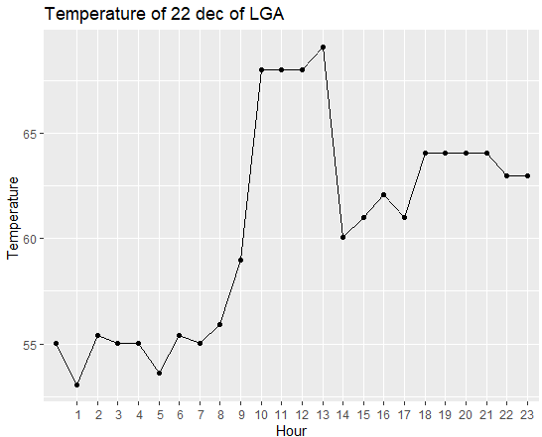
Analysis
Analysis11: Comparing the temperature of Dec 22 of JFK and LGA
Temperature in LGA airport is higher than JFK in 22 December
At 13 o’clock, the temperature is found higher i.e., 69.08 degrees Fahrenheit in LGA
At 19 o’clock, the temperature is found higher i.e., 60.80 degrees Fahrenheit in JFK

Slide 15
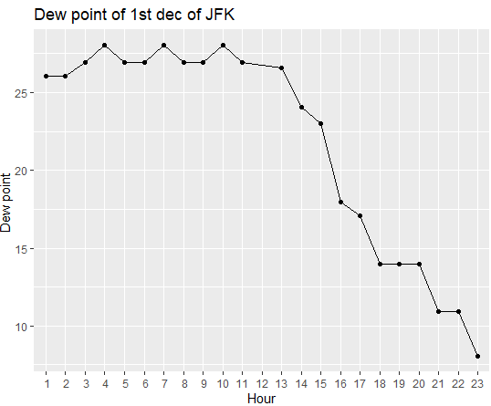
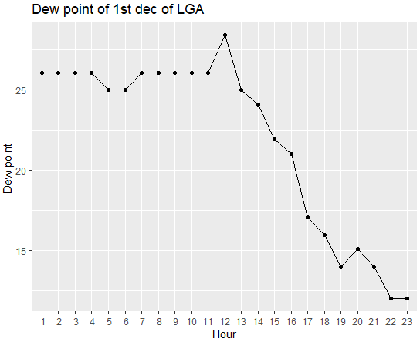
analysis
Analysis12: Comparing the hourly dew point of 1st January of JFK and LGA
Dew point on 1st January in LGA airport is higher than JFK
At 12 o’clock, the dew point is found higher i.e., 28.40 degrees Fahrenheit in LGA
At 4, 7, 11 o’clock, the dew point is found constant and higher (20.04 degrees Fahrenheit) in JFK

Slide 16
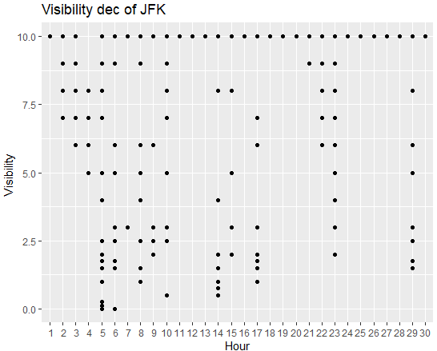
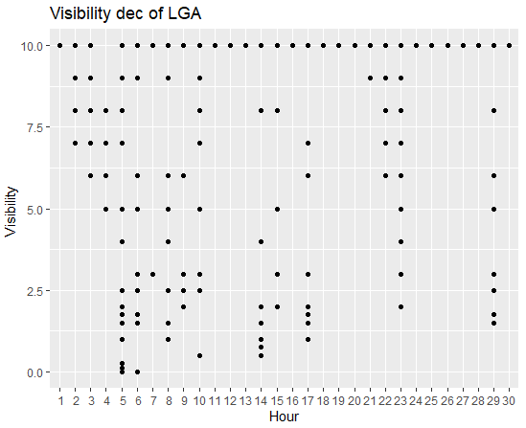
analysis
Analysis13: Comparing the visibility of December of JFK and LGA
The maximum visibility in LGA and JFK are the same (i.e., 10 miles)
Maximum value found on all the days except the 4th of December in both JFK and LGA
The minimum visibility is found in LGA which is 0.00 miles

Slide 17
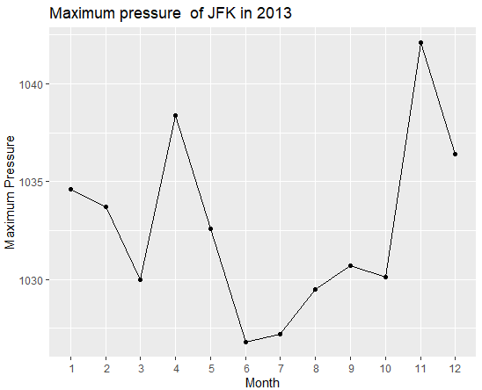
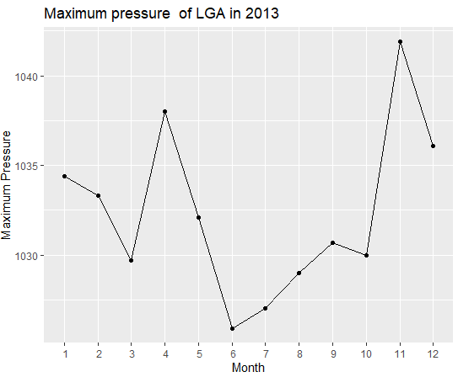
analysis
Analysis14: Comparing the maximum pressure of 2013 in JFK and LGA
Maximum pressure in LGA and JFK is found in November
Pressure in JFK is found to be 1042.1milli bars which is higher than 1041.9 mill bars of LGA
Least value of maximum pressure is found in June month of both airports
(985.7 in JFK and 983.8 in LGA).

Slide 18
conclusion
Helped us to be able to implement the concepts related to R programming
Make us able to implement suitable data pre-processing, data exploration, data manipulation and data visualization techniques
Improve the result of the data analysis which is useful for decision making
Helps to build carrier in the field data science

Slide 19
references
DataMentor. 2022. R boxplot() to Create Box Plot (With Numerous Examples). [online] Available at: <https://www.datamentor.io/r-programming/box-plot/> [Accessed 7 March 2022].
Medium. 2022. Understanding Boxplots. [online] Available at: <https://towardsdatascience.com/understanding-boxplots-5e2df7bcbd51> [Accessed 8 March 2022].
Rdocumentation.org. 2022. hist function - RDocumentation. [online] Available at: <https://www.rdocumentation.org/packages/graphics/versions/3.6.2/topics/hist> [Accessed 8 March 2022].
Rdocumentation.org. 2022. smooth function - RDocumentation. [online] Available at: <https://www.rdocumentation.org/packages/stats/versions/3.6.2/topics/smooth> [Accessed 7 March 2022].
Statmethods.net. 2022. Quick-R: Scatterplots. [online] Available at: <https://www.statmethods.net/graphs/scatterplot.html> [Accessed 7 March 2022].
Vries, A., 2022. Interpolation and smoothing functions in base R. [online] Revolutions. Available at: <https://blog.revolutionanalytics.com/2015/09/interpolation-and-smoothing-functions-in-base-r.html> [Accessed 8 March 2022].

